Slide 1

Faculty Performance Based Appraisal System
Presented By-
Ritika Barethia
Shubham Neema
Sweta Rathore
Vikas Chouhan

Slide 2
International Institute of Professional Studies
Davv

Slide 3
Introduction
To design and develop a Computerized System, it is necessary to manage information of faculties more effectively using the concepts of database design and easy-to-use GUI interface which would help the user to save time and effort.

Slide 4
Objective
Computerization of present system which results in effective and efficient use of time and effort.
Integrating information at one place.
To provide security of information.
To increase efficiency of Information management.
Storing Academic ,Personal and Professional at a one place.
To generate reports at a single click.

Slide 5
Technologies Used
Git
Asynchronous Javascript And XML
Bootstrap
Hypertext Preprocessor

Slide 6

Git is a version control system(VCS) for tracking changes in computer files and coordinating work on those files among multiple people.
It is primarily used for software development ,but it can be used to keep track of changes in any files.
As a distributed revision control system it is aimed at speed, data integrity, and support for distributed, non-linear workflows.
All your code in one place.

Slide 7

Bootstrap is a free and open-source front-end web framework for designing websites and web applications.
It contains HTML and CSS based design templates for forms, buttons, navigation and other interface components, as well as optional JavaScript extensions.
Unlike many web frameworks, it concerns itself with front-end development only.
Bootstrap supports responsive web design.

Slide 8

AJAX stands for Asynchronous JavaScript and XML. It is a technique used to make webpages faster to use.
If they are programmed with AJAX, they seem to react faster.
They only send small bits of information to the web server. That way the whole web page does not need to reload, only small parts of it.

Slide 9

456

Slide 10
Other Technologies
Html
Css
Java Script
Sql (Backend)
Wamp Server

Slide 11

45

Slide 12
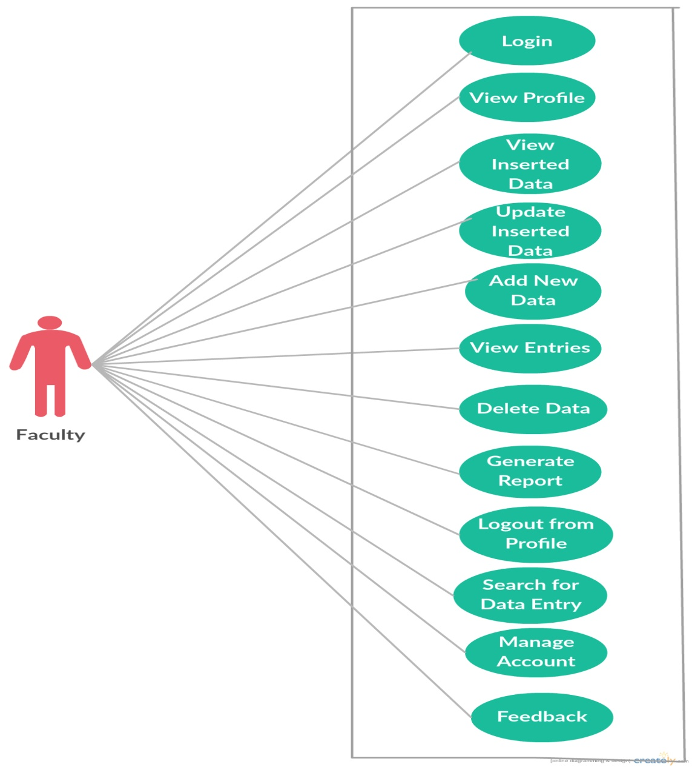
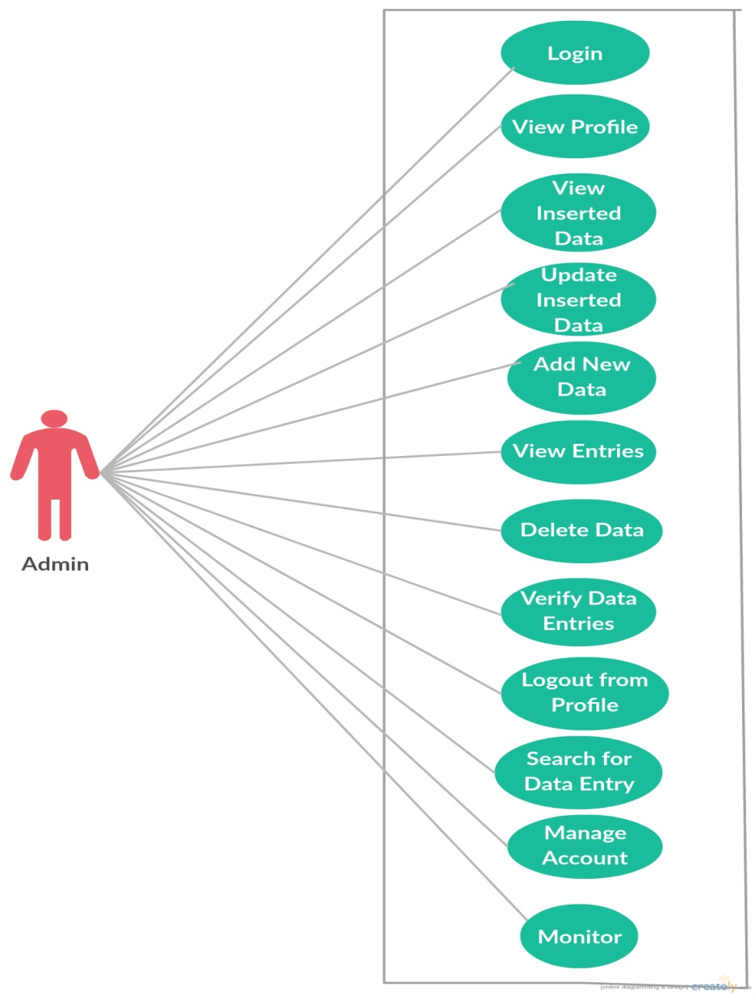
Use Case

Slide 13
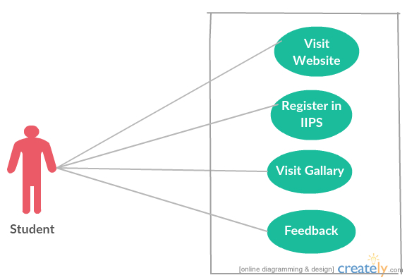
Use Case...conti..

Slide 14
Flow Chart
1. Google Login

Slide 15
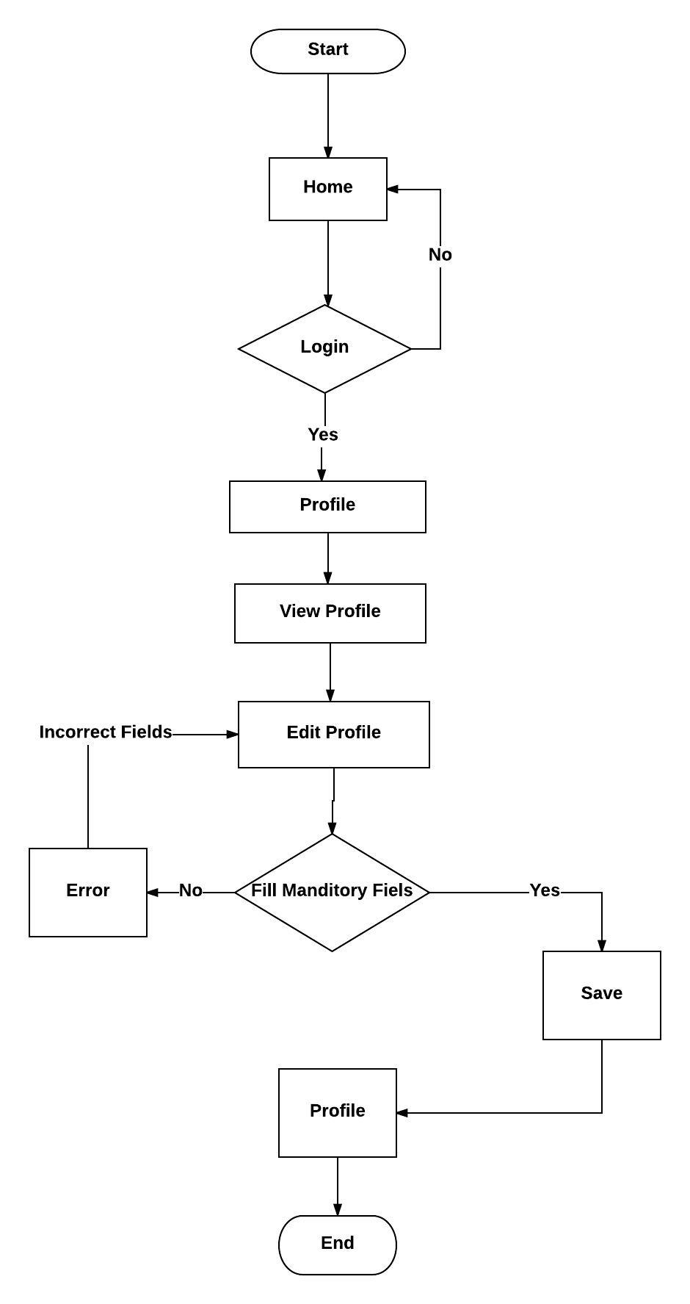
Flow Chart
2.. View Profile

Slide 16
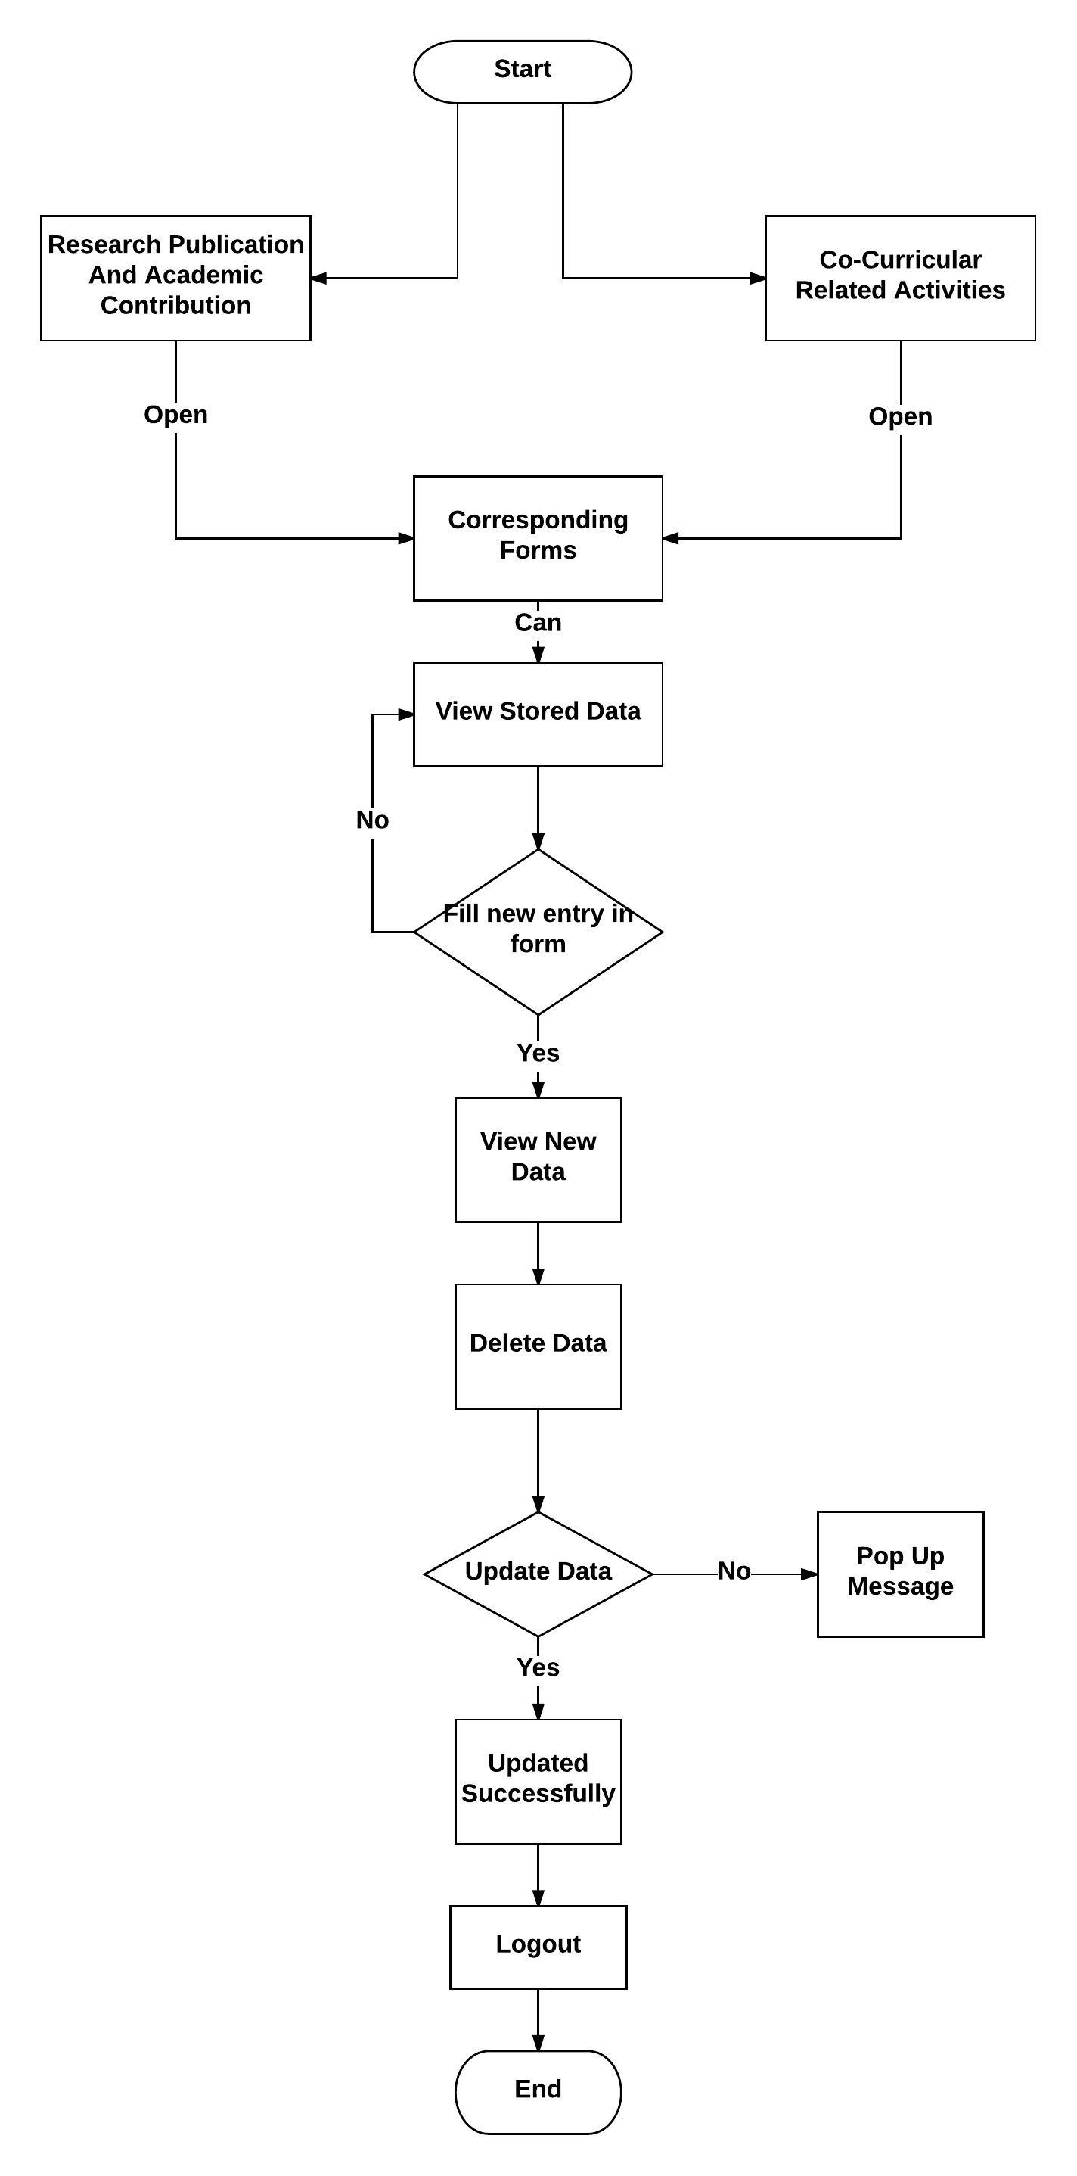
Flow Chart
3. Rearch Publication and Co- curicullar activities forms

Slide 17
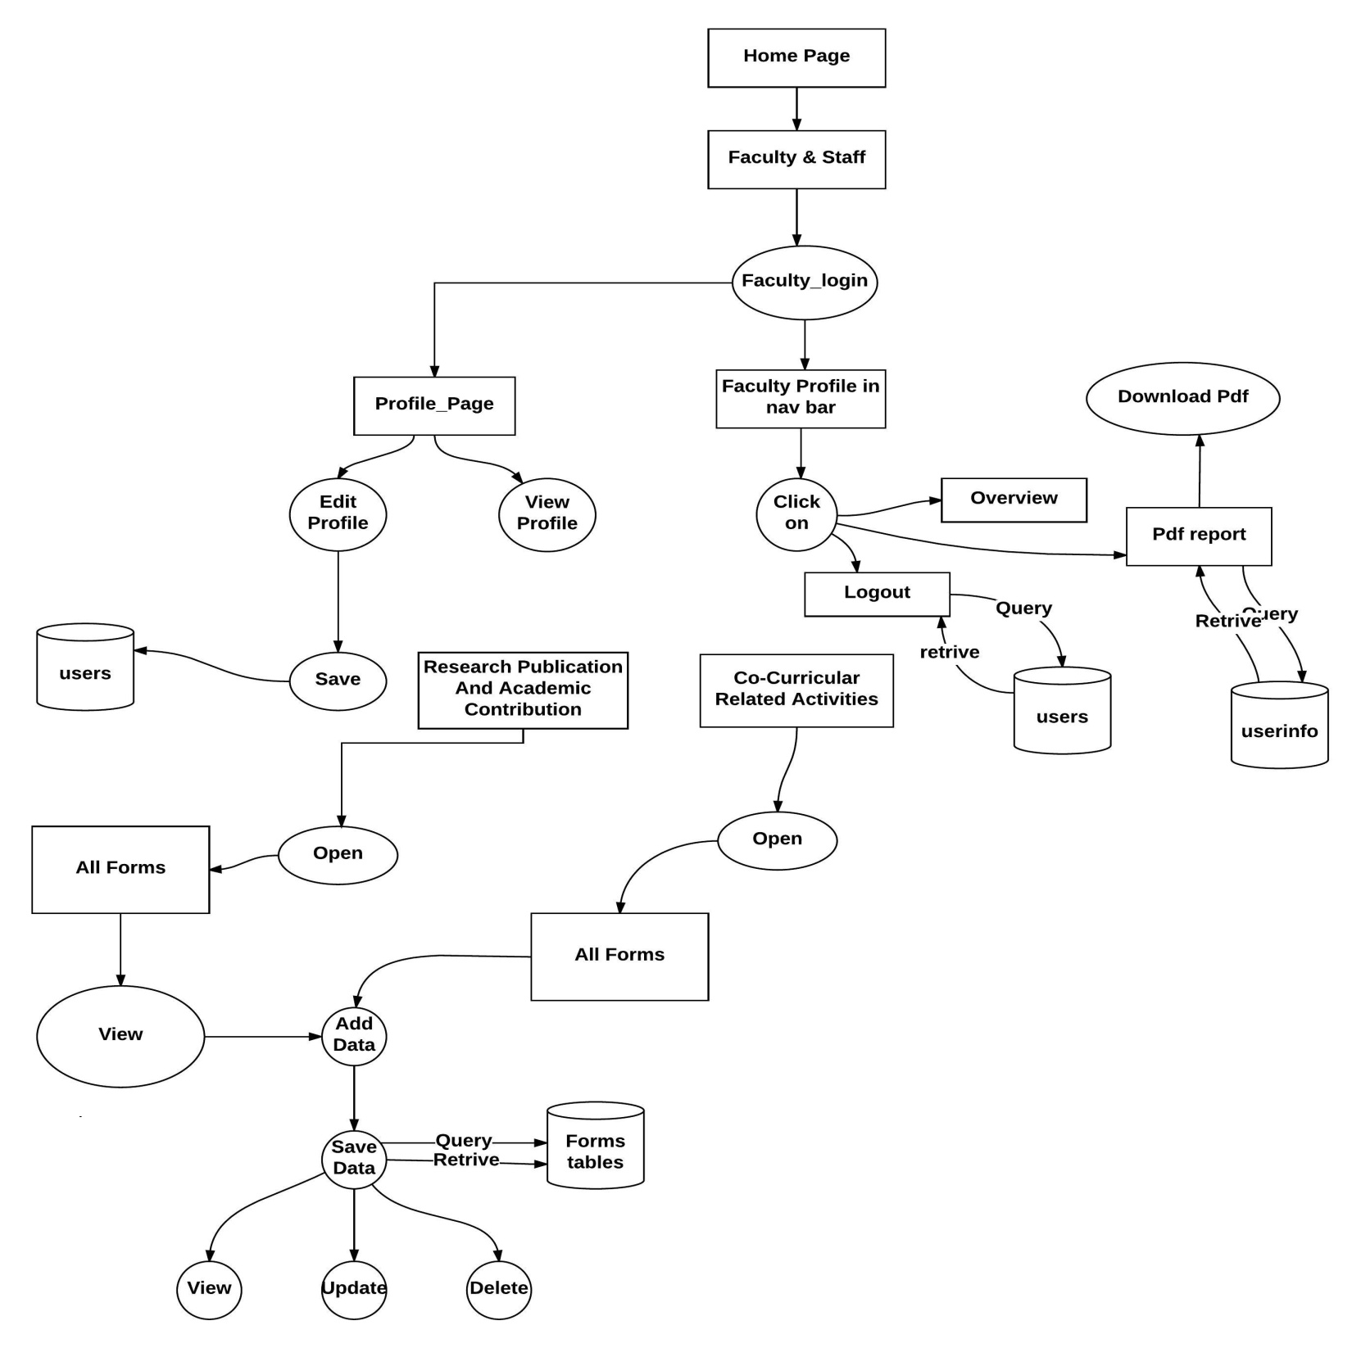
Data Flow Diagram

Slide 18
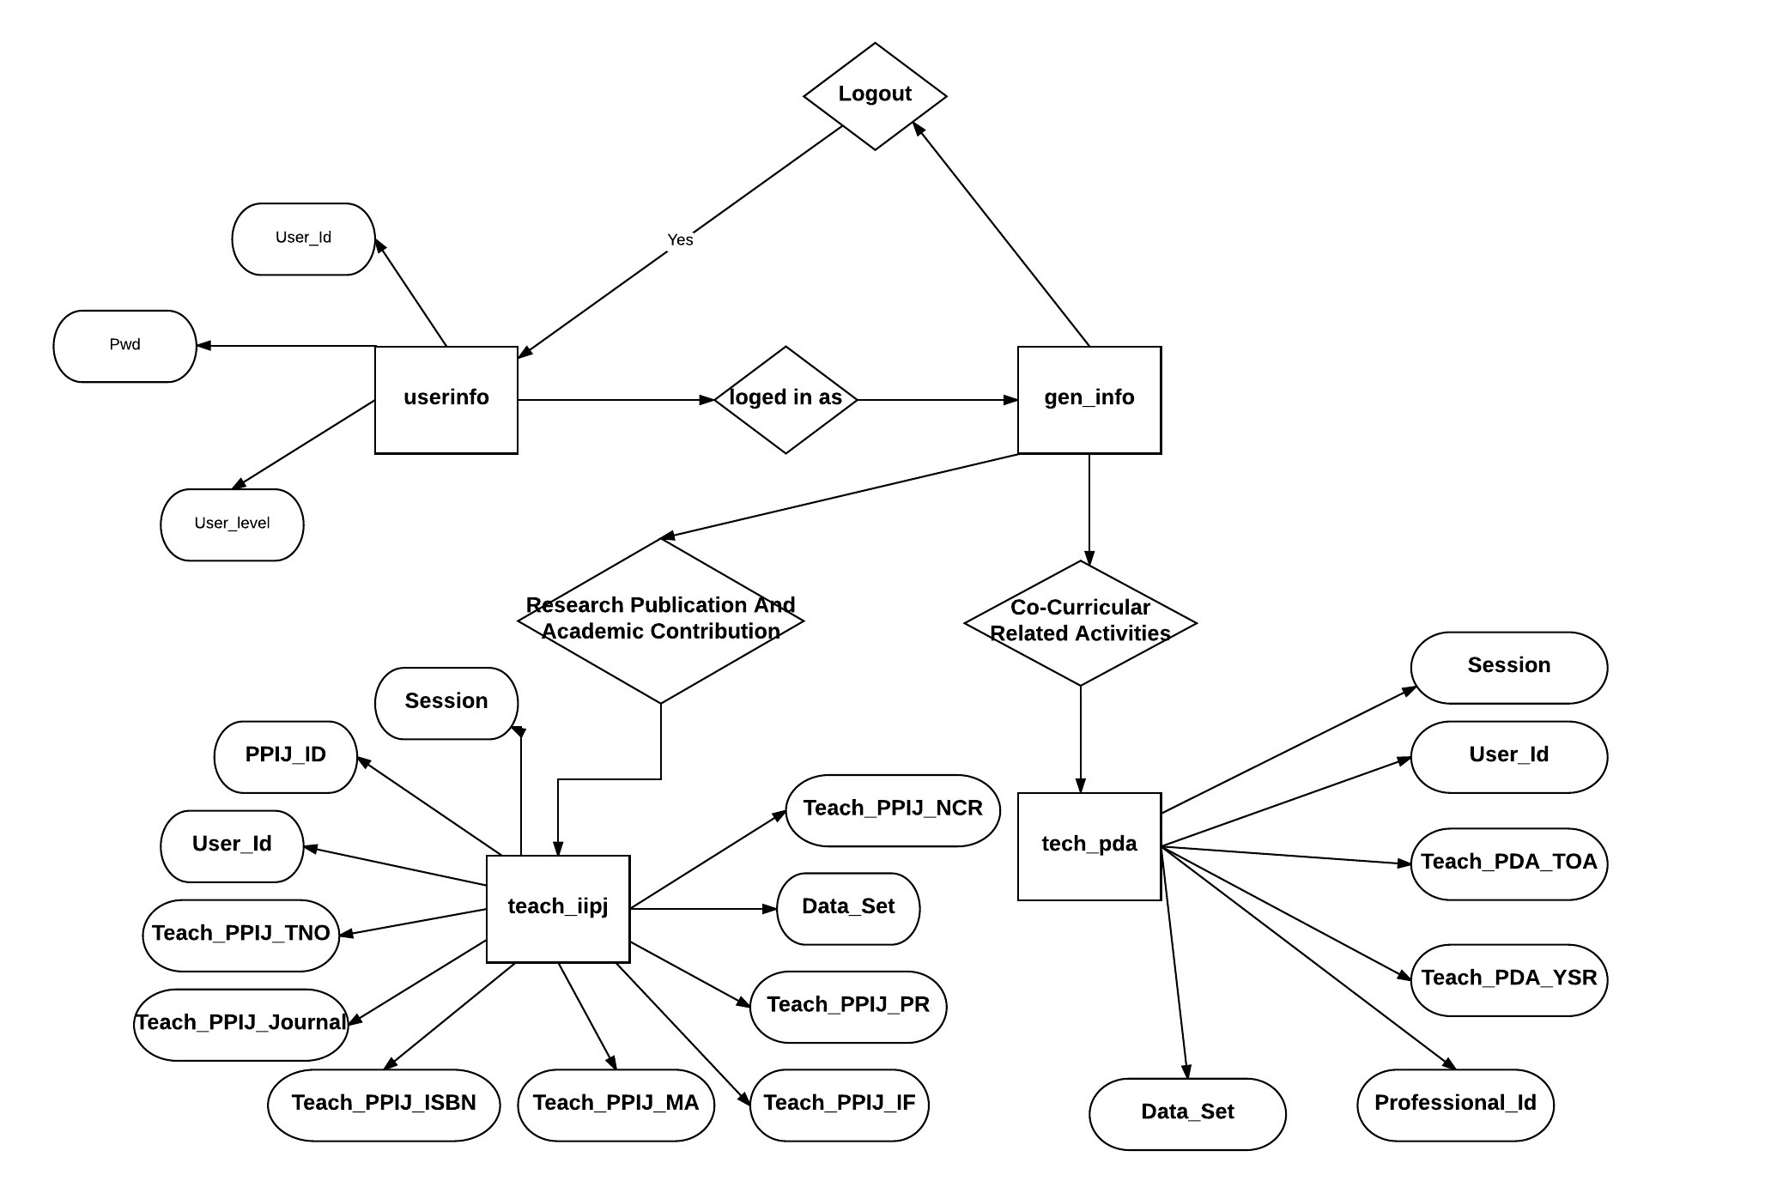
ER Diagram

Slide 19
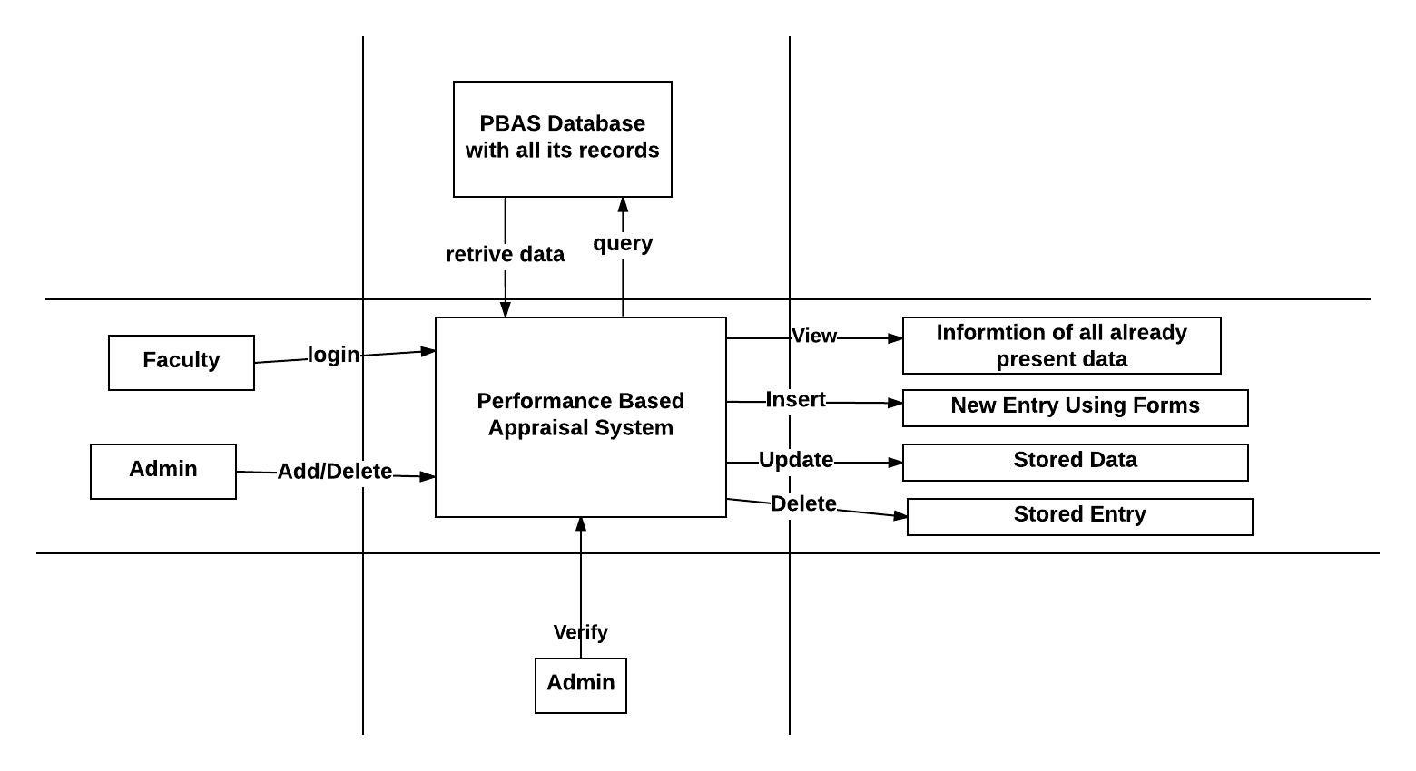
System Diagram

Slide 20
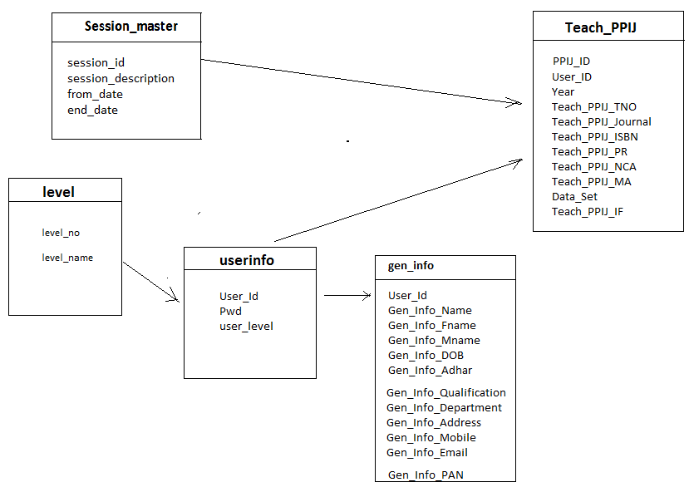
Class Diagram

Slide 21
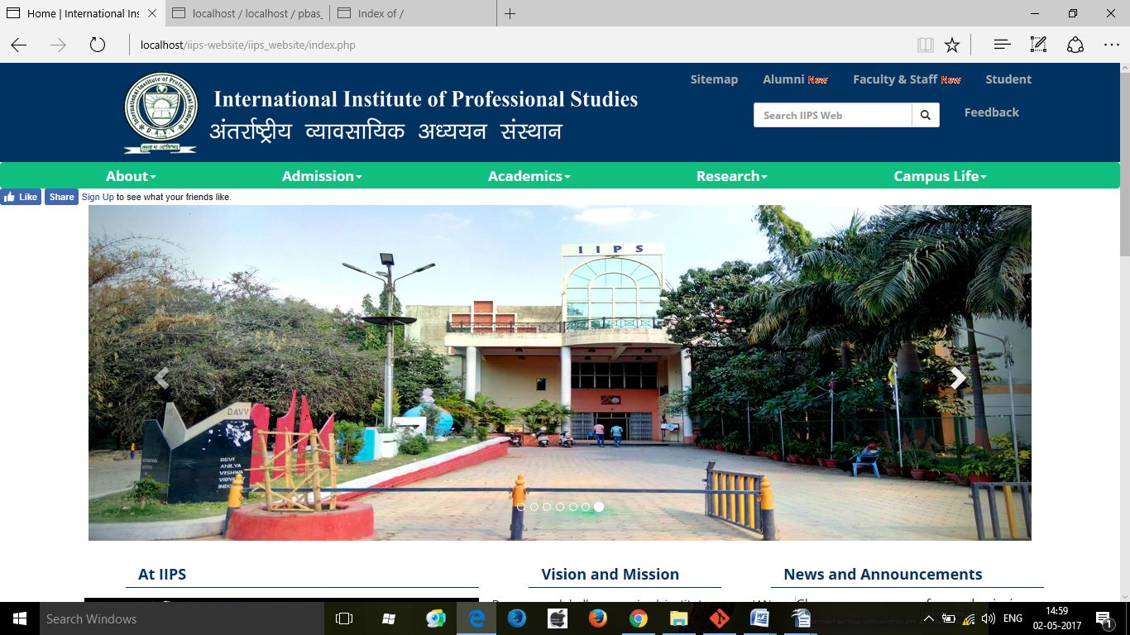
User Interfaces
IIPS College Website

Slide 22
User Interface
Login

Slide 23
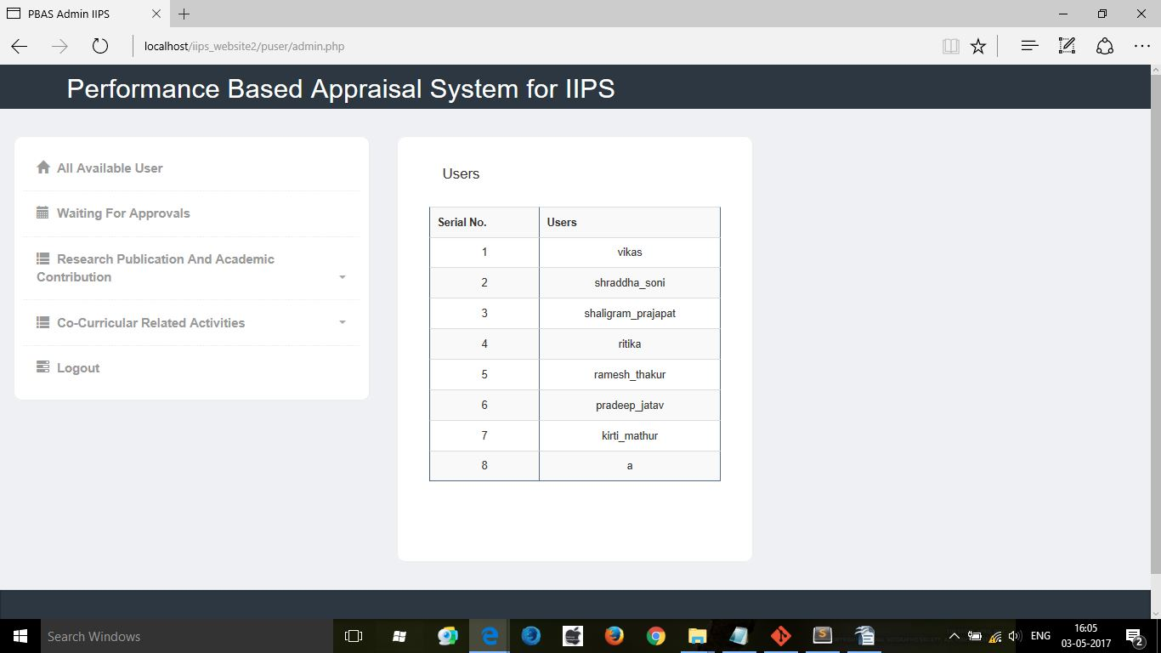
User Interface
Admin

Slide 24
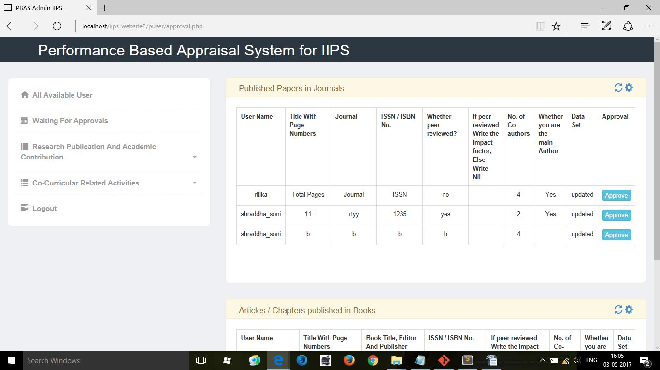
User Interface
Admin Approval System

Slide 25
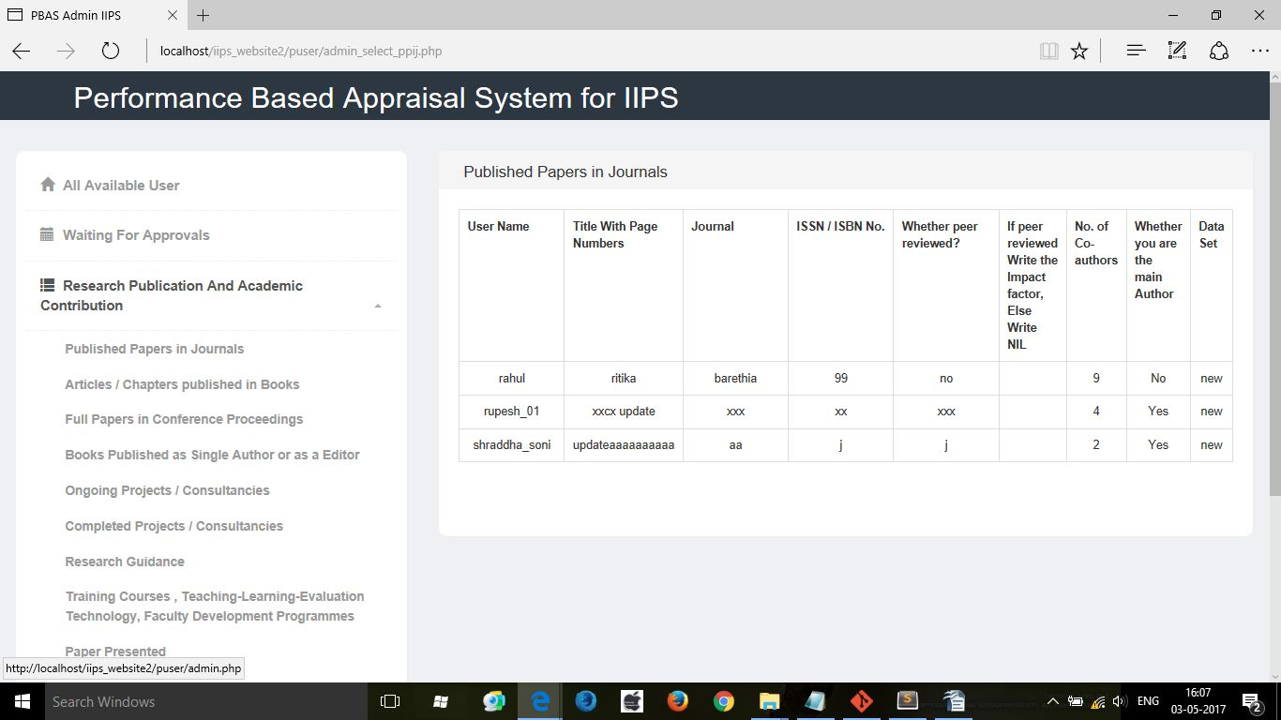
User Interface
Admin View All Entries

Slide 26
User Interface
Login

Slide 27
User Interface
Login

Slide 28
User Interface
Login

